Slide 1

SMART AI-BASED SURVEILLANCE SYSTEM
Guided by:
Mr. Surojit Bhattacharyya
Assistant Professor
Computer Science and Engineering

Slide 2
TEAM MEMBER DETAILS
SINCHANA CHATTERJEE, CSE-DS/2021/001
MEHULI BISWAS, CSE-DS/2021/035
RIYANKA NAG, CSE-DS/2021/039
ANKITA UPADHYAY, CSE-DS/2021/055

Slide 3
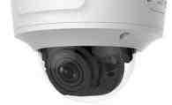
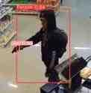
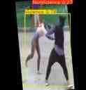
INTRODUCTION
Ensuring safety in today’s busy urban environments is a growing challenge. Traditional surveillance, which depends on human monitoring, often falls short in covering large, complex spaces, leading to potential security gaps where threats may go undetected.
Purpose of the Project : The Smart AI-Based Surveillance System addresses these limitations by utilizing computer vision techniques to detect potential threats such as violence, weapons, and suspicious behavior in real time. This project aims to enhance public safety by enabling instant alerts to security teams or law enforcement upon detecting suspicious activity. The system’s rapid notification feature enables quick response times, reducing risks in public spaces.
Focus Areas for This Semester: This semester's work focuses on implementing the YOLO computer vision algorithm to detect weapons and violent behavior. This approach represents a significant advancement in public safety technology, as it automates critical aspects of surveillance, providing actionable insights that help make public spaces safer and more secure.

Slide 4
OVERVIEW OF YOLO ALGORITHM
YOLO (You Only Look Once) is a cutting-edge computer vision algorithm designed for real-time object detection.
Unlike traditional approaches, such as Region-Based Convolutional Neural Networks (R-CNN), Sliding Window Detection, and Two-Stage Detectors like Faster R-CNN and Mask R-CNN, which process images in multiple stages, YOLO treats detection as a single unified task (a single-stage detector). This streamlined approach makes YOLO highly efficient and well-suited for real-time surveillance applications.
Strengths of the YOLO Algorithm:
High Accuracy: Known for its precision in detecting objects within images, even in crowded or complex scenes.
Speed: Capable of processing images in real time, making it ideal for continuous surveillance and rapid response scenarios.
Robustness: Performs well in various environmental conditions (e.g., low lighting, outdoor settings), ensuring reliable threat detection across diverse public spaces.

Slide 5
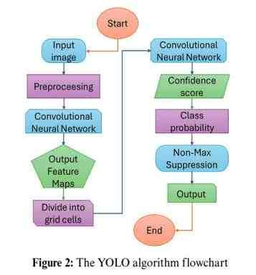
WORKING OF YOLO ALGORITHM
The flowchart illustrates the working of the YOLO (You Only Look Once) algorithm for object detection, which is used in YOLOv11 in this project.
1. Input Image: The process starts with an input image.
2. Preprocessing: The image undergoes preprocessing to prepare it for analysis.
3. Convolutional Neural Network (CNN): The CNN extracts features from the image, producing output feature maps.
4. Divide into Grid Cells: The image is divided into a grid. Each cell in the grid will predict bounding boxes and associated probabilities for objects it detects.
5. Confidence Score: The model calculates confidence scores for each bounding box, indicating the likelihood that an object is present.
6. Class Probability: The model then calculates probabilities for each class (type of object).
7. Non-Max Suppression: This step eliminates duplicate boxes, keeping only the most accurate one per object.
8. Output: The algorithm produces final bounding boxes with class labels and probabilities.

Slide 6
REASON TO USE YOLOv11 FOR OUR PROJECT WORK
The latest YOLO version, YOLOv11, introduces a more efficient architecture with C3K2 blocks, SPFF (Spatial Pyramid Pooling Fast), and advanced attention mechanisms like C2PSA. YOLOv11 is designed to enhance small object detection and improve accuracy while maintaining the real-time inference speed that YOLO is known for.
DIFFERENCE BETWEEN YOLOv8 and YOLOv11
FEATURE | YOLOv8 | YOLOv11
Detection Accuracy | Moderate; struggles with complex, overlapping objects | Higher; improved localization and better handling of complex scenes
Speed and Efficiency | Real-time, but can slow down for high-resolution images | Faster and more efficient for real-time processing, even at high resolutions
Object Tracking | Limited tracking capabilities | Enhanced tracking, potentially including multi-object tracking
Anchor-Free Detection | Partially implemented | More advanced anchor-free methods, reducing computation and increasing accuracy
Behavioral Analysis | Basic detection and limited behavioral insights | Advanced behavioral analysis and anomaly detection capabilities
Complexity | Easier to deploy, suitable for general tasks | More sophisticated, with flexible deployment options and fine-tuning

Slide 7
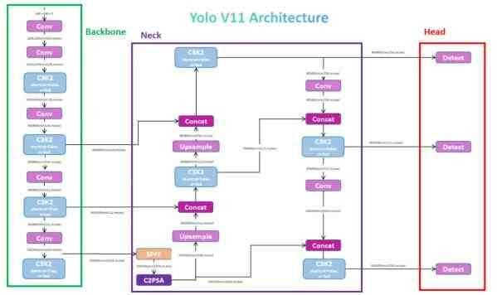
YOLOv11 ARCHITECTURE
Backbone: This component extracts features from the input image. These features are the essential elements that the model uses to identify objects.
Neck: The neck collects the extracted features from the backbone and prepares them for further processing. It acts as a bridge between the backbone and the head.
Head: The head is responsible for making the final predictions about the objects in the image. It analyzes the processed features from the neck and generates bounding boxes and class probabilities for each detected object.

Slide 8
DATASET DESCRIPTION
This project uses two datasets: one for weapon detection and another for violence detection. The datasets consist of images with varying resolutions, each annotated with bounding boxes around and objects.
TABLE I. PARTITION OF TESTING, VALIDATION, AND TRAINING SETS FOR WEAPON DETECTION DATASET
TABLE II. PARTITION OF TESTING, VALIDATION, AND TRAINING SETS FOR VIOLENCE DETECTION DATASET
Dataset Size Weapon Detection: 5,468 images Violence Detection: 2,834 images | Dataset Link Weapon Detection: https://universe.roboflow.com/joo-assalim/fireguns-and-knifes-detector/dataset/3 Violence Detection: https://universe.roboflow.com/shah-xxxqs/violence-3h8pw/dataset/1
Set name | No. of samples | Set proportion (%)
Training | 4726 | 86%
Validation | 470 | 9%
Testing | 272 | 5%
Set name | No. of samples | Set proportion (%)
Training | 1969 | 70%
Validation | 575 | 20%
Testing | 290 | 10%

Slide 9
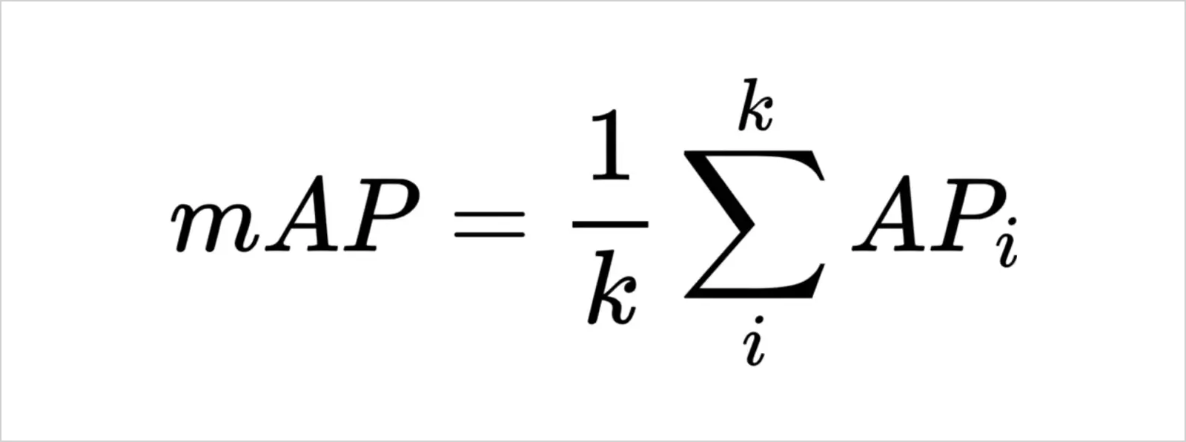



EVALUATION METRICS
mAP (Mean Average Precision): It is the mean of the Average Precision (AP) across all object classes that the model is trained to detect.
Average Precision (AP): Measures the area under the Precision-Recall curve for each class.
In the formula of AP (Average Precision) p(r), represents the precision at a specific recall level r. The average precision value is high if precision and recall are both high and low when one or both of them lie below the model's confidence score threshold.
Precision: The ratio of true positive predictions (e.g., correctly detected weapons or violent actions) to the total number of positive predictions. It indicates how accurate the threat detections are.
Recall: The ratio of true positive predictions to the total number of actual threat instances. It shows how well the model identifies relevant dangers.

Slide 10

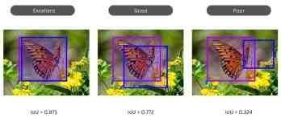
EVALUATION METRICS
Intersection over Union (IoU): For each detected object, the IoU compares the predicted bounding box with the ground truth bounding box. If IoU exceeds a predefined threshold (e.g., 0.5), it counts as a true positive; otherwise, it is a false positive.
where, Area of Intersection = Common area shared by the two bounding boxes (Overlap). Area of Union = Total area covered by the two bounding boxes.
Confidence Score: the probability of a bounding box containing an object.
C = Pr(object) * IoU
a higher confidence score indicates a greater likelihood that the bounding box actually contains an object within the image, meaning the model is more confident about the detection within that box.
Non-Max Suppression: When multiple bounding boxes are detected, the ones with higher confidence scores are usually kept after applying non-max suppression, which removes redundant detections.
Object Detection at Different IoU Threshold Examples

Slide 11
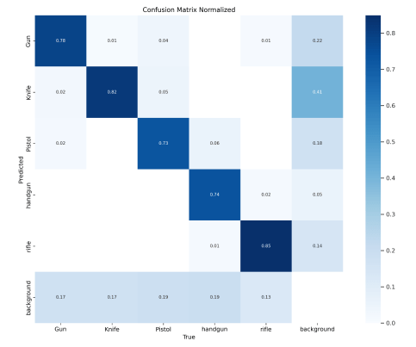
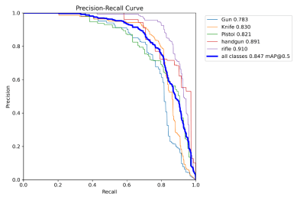
MODEL EVALUATION: Weapon Detection
TABLE. PERFORMANCE METRICS OF THE WEAPON DETECTION MODEL
Class | Images | Instances | Box(P) | Box(R) | mAP50 | mAP (mean)
all | 470 | 739 | 0.846 | 0.732 | 0.846 | 0.629
Gun | 73 | 120 | 0.843 | 0.675 | 0.782 | 0.571
Knife | 178 | 220 | 0.811 | 0.791 | 0.83 | 0.564
Pistol | 100 | 128 | 0.82 | 0.642 | 0.82 | 0.635
Handgun | 70 | 72 | 0.834 | 0.736 | 0.889 | 0.689
Rifle | 163 | 199 | 0.919 | 0.814 | 0.91 | 0.685

Slide 12
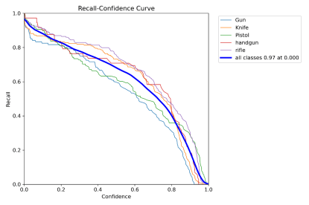
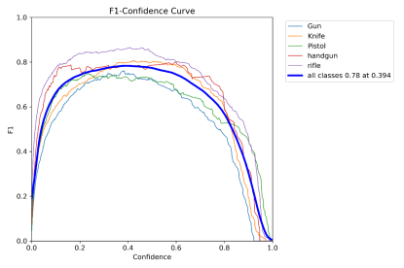
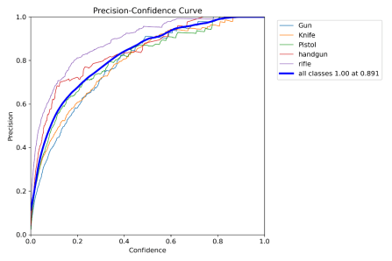

Slide 13
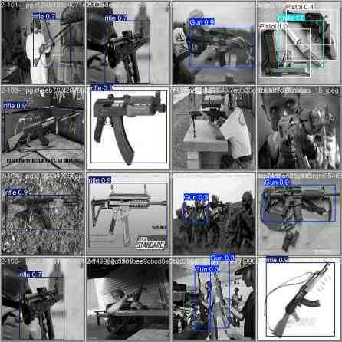
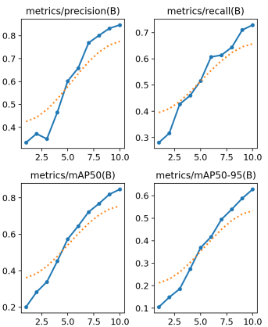
The YOLOv11 model achieved an overall mAP of 0.846 and mean mAP(50-90) of 0.629 in detecting weapons.
Sample images from the Validation set demonstrating
weapon detection results

Slide 14
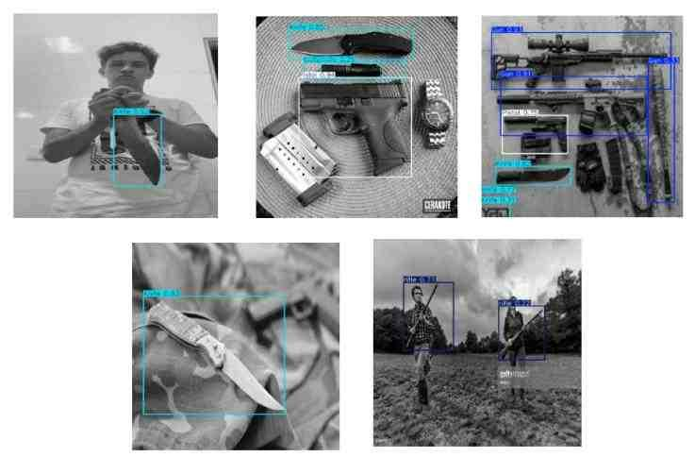
Sample images from the test set demonstrating weapon detection results

Slide 15
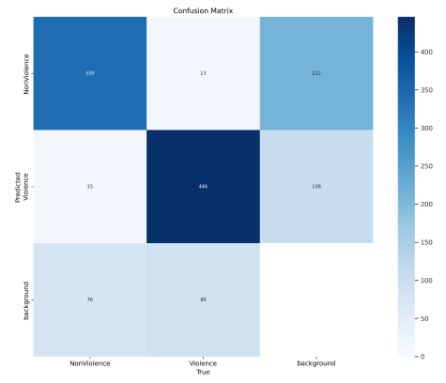
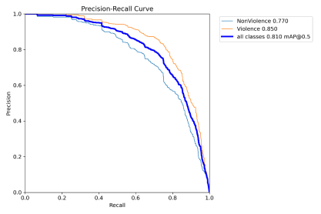
MODEL EVALUATION: Violence Detection
TABLE. PERFORMANCE METRICS OF THE VIOLENCE DETECTION MODEL
Class | Images | Instances | Box(P) | Box(P) | mAP50 | mAP (mean)
All | 575 | 978 | 0.771 | 0.730 | 0.811 | 0.477
Non-Violence | 220 | 430 | 0.692 | 0.731 | 0.772 | 0.456
Violence | 529 | 548 | 0.850 | 0.728 | 0.850 | 0.498

Slide 16
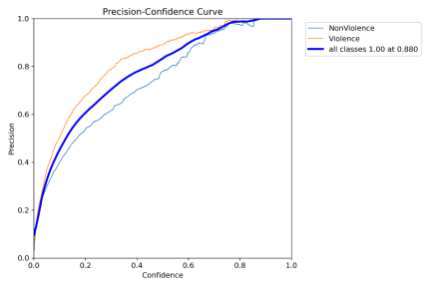
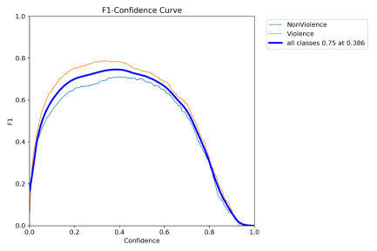
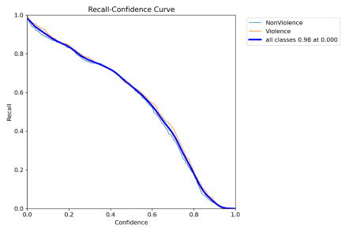

Slide 17
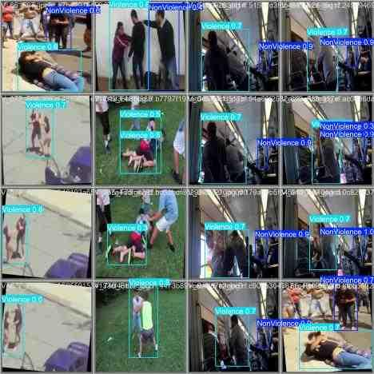
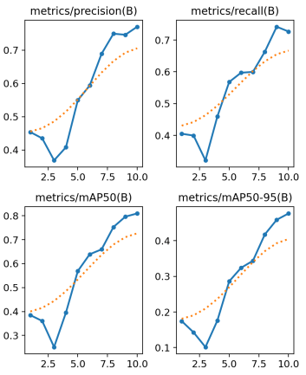
The YOLOv11 model performed well in detecting violent actions, achieving an overall mAP50 of 0.811 and a mean mAP of 0.477.
Sample images from the Validation set demonstrating
Violence detection results

Slide 18
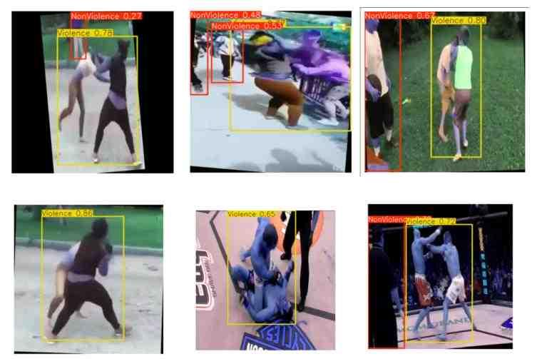
Sample images from the test set demonstrating violence detection results

Slide 19






ROADMAP OF PROJECT WORK
This semester, we are focused on studying the YOLOv11 model and evaluating its performance in weapon and violence detection. YOLOv11 achieves a mean Average Precision (mAP) of approximately 80% for both weapon and violence detection tasks.
7th Sem
6th Sem
8th Sem
Last semester, our focus was on reviewing foundational research and examining prior studies relevant to our field. We aimed to build a strong understanding of the existing literature and methodologies. This groundwork has prepared us for more advanced work in the current semester..
Our future work will focus on behavioral analysis and the development of a real-time alert system capable of immediately notifying security personnel in response to detected threats, such as acts of violence, robbery, or other suspicious behaviors.

Slide 20
CHALLENGES AND ETHICAL CONCERNS
Privacy and Consent
Collecting and storing video data raises privacy concerns, especially in public spaces where individuals have not explicitly consented.
Balancing the need for security with the privacy rights of individuals requires careful consideration and clear policy frameworks.
Bias and Fairness
AI surveillance systems can unintentionally develop biases, especially in facial recognition, leading to inaccurate identification of certain demographics.
Ensuring the system is fair and inclusive for all individuals requires robust testing and possibly third-party audits of the technology.
Data Security and Cyber Threats
Collected surveillance data is vulnerable to cyber threats, making secure storage and transmission crucial to avoid breaches.
Systems need to comply with data privacy laws like GDPR to ensure proper handling and deletion of data when no longer needed.

Slide 21
COMPARISON WITH OTHER SURVEILLANCE TECHNOLOGIES
Comparison with Other Surveillance Technologies
Traditional Surveillance
Traditional surveillance systems rely heavily on manual monitoring, often leading to human error and slow response times.
These systems lack real-time analytics capabilities, making it challenging to detect potential threats before incidents occur.
AI-Based Surveillance Advantages
AI enhances surveillance with capabilities like object and behavior recognition, allowing for proactive, real-time alerts to potential threats.
AI-based systems require less human intervention, making them cost-effective and more accurate over time as algorithms improve.
Cost-Benefit Analysis
Though initial costs for AI-based surveillance are higher, long-term benefits include lower manpower needs and better threat detection accuracy.
Organizations can save on long-term operational costs with automated surveillance that doesn’t require continuous human oversight.

Slide 22
REFERENCES
[1] D. Choqueluque-Roman and G. Camara-Chavez, “Weakly supervised violence detection in surveillance video,” Sensors 2022, 22(12), 4502. https://doi.org/10.3390/s22124502
[2] H. Gao “A Yolo-based Violence Detection Method in IoT Surveillance Systems”, Research Gate Vol. 14, No. 8, 2023
[3] P. More, S. Patil, T. Pattanshetti, “Real time Violence and Weapon detection and Alert System” Research Gate May 21st, 2024. https://doi.org/10.21203/rs.3.rs-4389485/v1
[4] Md. Tahir Bhatti, Md. Gufran Khan, Masood Aslam, Md. Junaid Fiaz, “Weapon Detection in Real-Time CCTV Videos using Deep Learning”, February 2021 ,IEEE Access PP(99):1-1, DOI: 10.1109/ACCESS.2021.3059170
[5] Atharv Belurkar1, Ashish Waghmare2, Sahil Mallick3, Nikhil Waghamode4, Prof. Reshma Totare5 “Weapon Detection using Yolov4, CNN” Volume 10 Issue IV Apr 2022, https://doi.org/10.22214/ijraset.2022.41702
[6] Sankaranarayanan, Aswin C., Ashok Veeraraghavan, and Rama Chellappa. “Object detection, tracking and recognition for multiple smart cameras.” Proceedings of the IEEE 96, no. 10 (2008): 1606-1624.
[7] Zhang, Shuai, Chong Wang, Shing-Chow Chan, Xiguang Wei, and Check-Hei Ho. “New object
detection, tracking, and recognition approaches for video surveillance over camera network.” IEEE
sensors journal 15, no. 5 (2014): 2679-2691.
[8] İbrahim Özcan, Yusuf Altun, Cevahir Parlak, “Improving YOLO Detection Performance of Autonomous Vehicles in Adverse Weather Conditions Using Metaheuristic Algorithms”, Appl. Sci. 2024, 14(13), 5841; https://doi.org/10.3390/app14135841

Slide 23
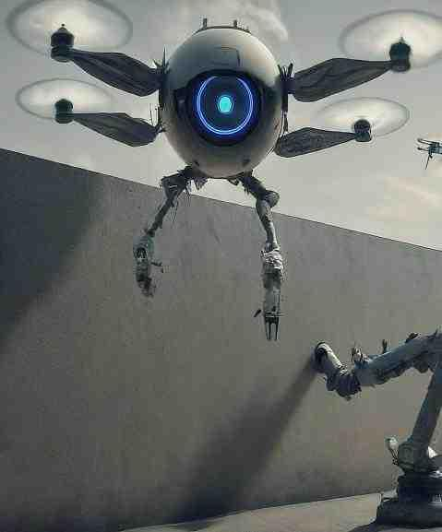
THANK YOU!

